Slide 1
Internet of Things-based Smart Switching and Controlling Modules with Computer Vision
Supervised by
Tanjum Rahi Akanto, Lecturer Department of EEE
Daffodil International University
Submitted by
Md. Hasemi Rafsan Jani Shohan
ID: 191-33-849
Board No:315

Slide 2
Introduction and overview
This project highlights their ongoing endeavor to contribute to the Fourth Industrial Revolution through the development of an IoT-based Smart Switching and Controlling Module with Computer Vision. that this project encompasses crucial elements of the Fourth Industrial Revolution and aims to transform the analog switching mechanism into an IoT-enabled system, allowing remote control from any location worldwide.
The project integrates various components such as a voltage dimmer, temperature sensor, and gas sensor. With these additions, users can obtain real-time information about temperature, humidity, and methane gas levels in a specific area, enhancing their situational awareness. The author expresses the belief that this project will simplify their daily tasks and contribute to advancements in electrical engineering technology.
I mention their plan to save all project data on a server, ensuring easy access and efficient management of information. They express hope that their project suggestions will inspire the development of future electrical projects. Additionally, computer vision and Gesture Control Phase Angle Converter are highlighted as crucial components of the project. I explain that they have developed computer vision software enabling remote visual inspection of controlled areas through video visualization. I believe this will significantly improve robotic vision capabilities. The passage concludes by mentioning the development of an Android IoT control app for the project, allowing users to control and monitor the system through their mobile devices.
Overall, the passage showcases the leveraging of IoT, computer vision, and gesture control in their project, aligning with the advancements of the Fourth Industrial Revolution.

Slide 3
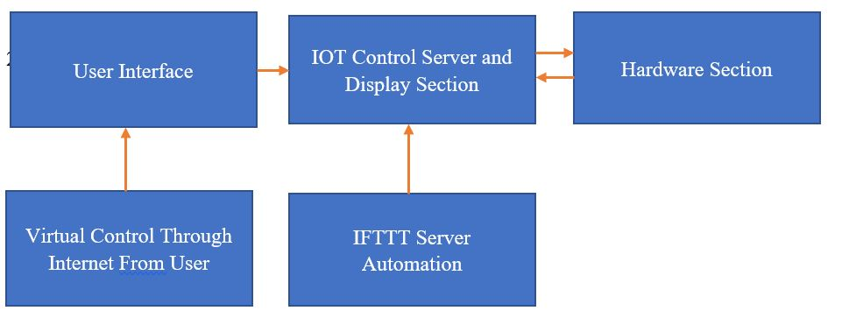
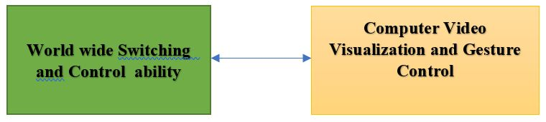
Overview and operation

Slide 4
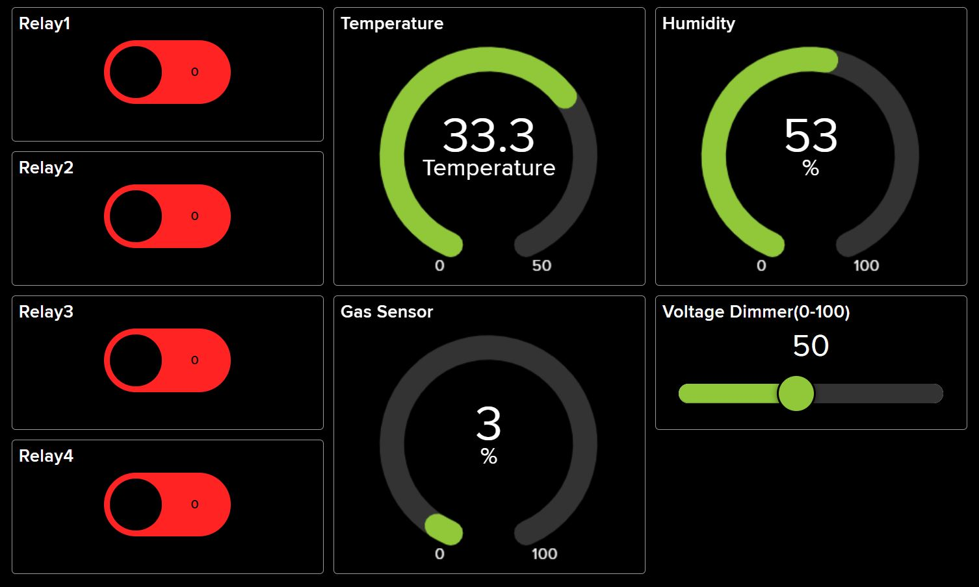
IoT(Internet of Things) BASED Controlling framework

Slide 5
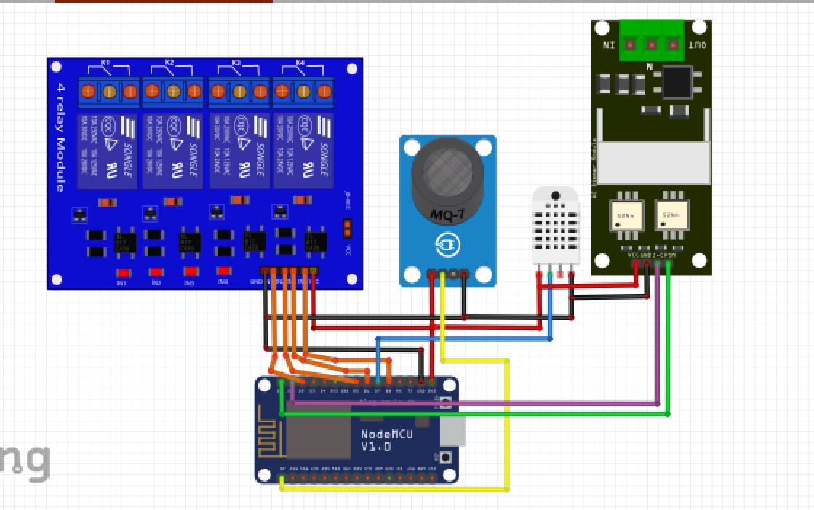
IoT Control Hardware Circuit
Relay Module
Relay Module
MQ2
Dimmer Module
DTH11
NODE MCU ESP8266

Slide 6
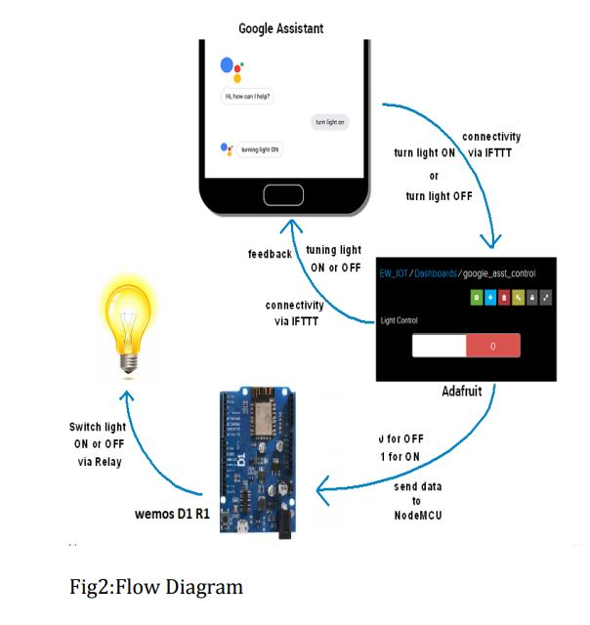
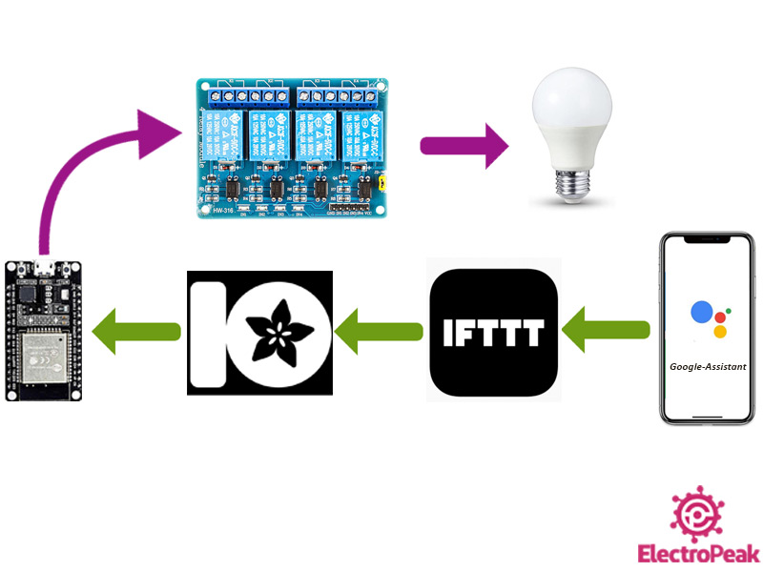
Working procedure of IOT control

Slide 7
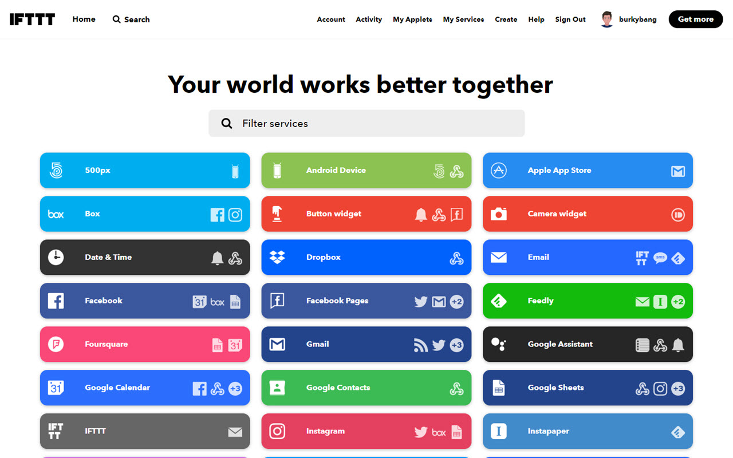
Features and applets of IoT project
IFTTT (If This, Then That) is a popular web-based service that allows users to create automated actions and workflows between different apps, services, and devices. It follows a simple "if this, then that" logic, where users can define triggers and actions to automate tasks.

Slide 8





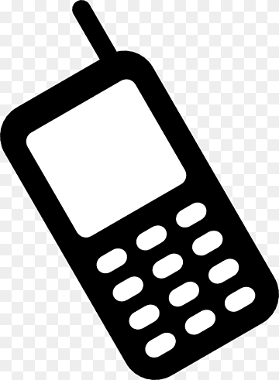
Service included in this project
Voice Recognize Activities
Google sheet for data storage
Time and Date based load control
Data and Alert-based Gmail Activities
GSM Control

Slide 9
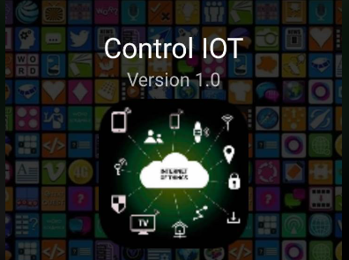
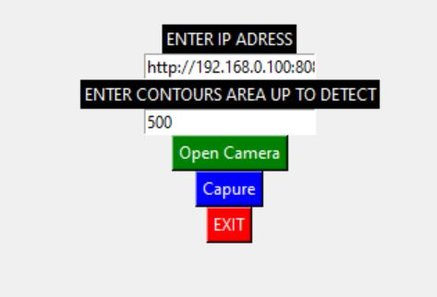
Control purpose development apps and software
Apps For IOT Control
Software Development For IOT Control

Slide 10
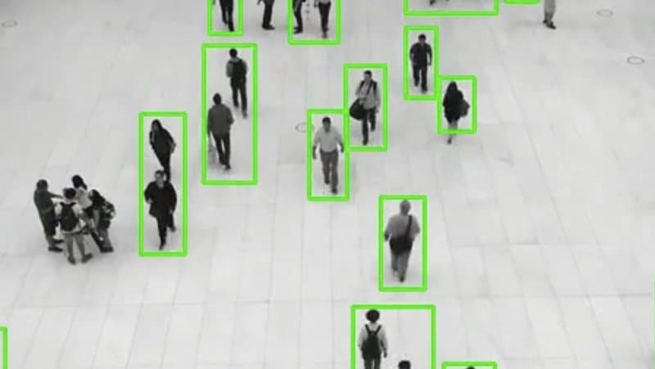
Movement-based visual inspection of IOT-controlled areas

Slide 11
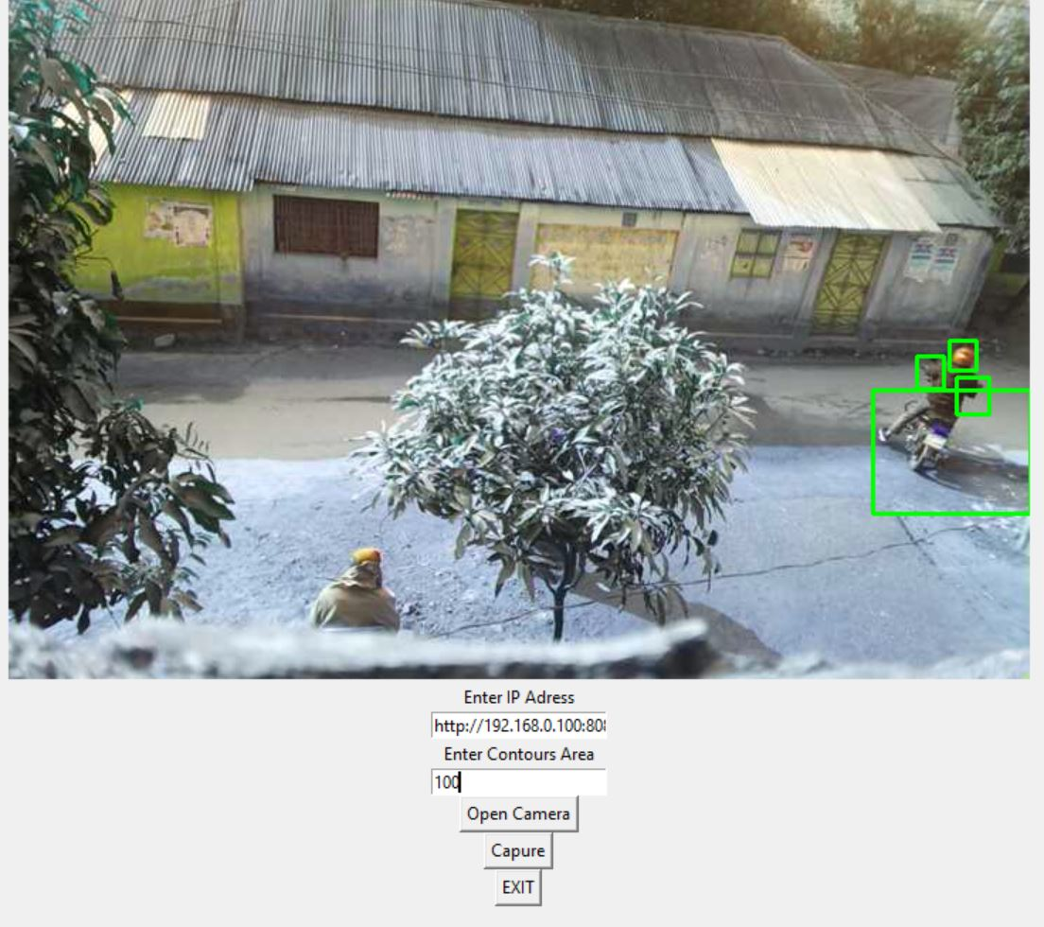
Visual inception process

Slide 12
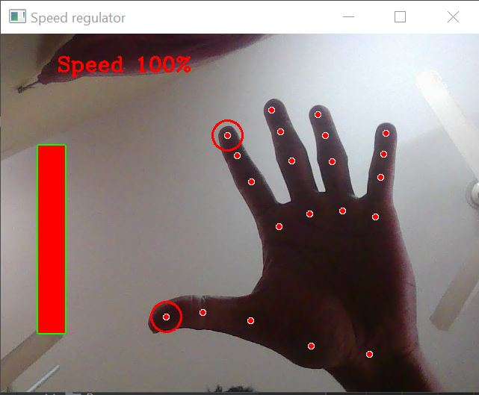
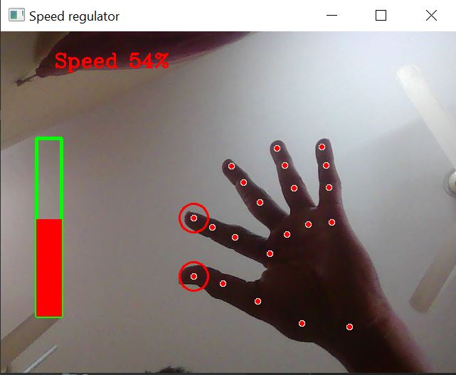
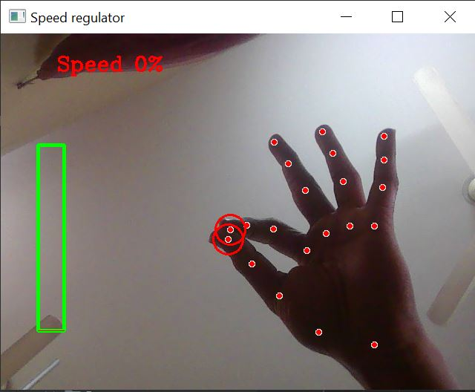

Gesture Movement-based Phase Control High-level to low level

Slide 13
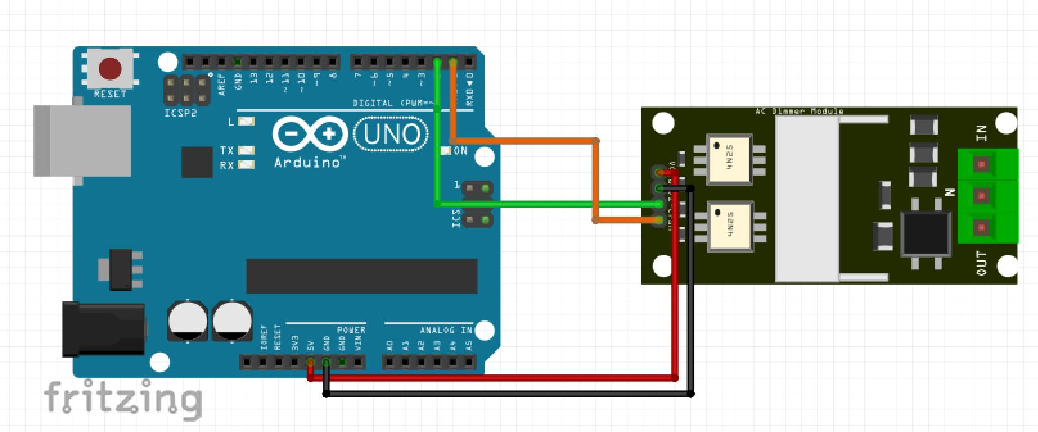
Hardware Arrangement of Gesture-based AC phase control
MICROCONTROLLER
Dimmer Module

Slide 14
DISCUSSION
The Internet of Things-based Smart Switching and Controlling Module with Computer Vision, utilizing hand gesture recognition for voltage dimmer control, revolutionizes home automation. It offers convenient and intuitive control of connected devices through simple hand movements. This project promotes energy efficiency, enables remote access, and enhances the user experience. With its scalability and integration capabilities, it creates a cohesive ecosystem for optimized device control. Overall, this innovative project combines IoT and computer vision technologies to create a seamless and efficient smart home experience.

Slide 15
Conclusion
The Internet of Things-based Smart Switching and Controlling Module with Computer Vision, incorporating hand gesture recognition for voltage dimmer control, demonstrates the potential for innovative and user-friendly control systems. By leveraging IoT and computer vision technologies, this project offers enhanced control, convenience, energy efficiency, and remote accessibility. The integration of gesture recognition opens up new possibilities for intuitive device control, benefiting individuals with limited mobility. Furthermore, the project's scalability, data insights, and educational potential make it a promising endeavor within the field of IoT-based home automation and control systems.

Slide 16
Thank you for watching

